Slide 1
Green business challenge
www.thegreenbusinesschallenge.nl

Slide 2
Green business challenge
Why the Green Business Challenge?
Boost the theme in the region (2022: circular economy)
Develop and showcase good examples
Introduce students to the themes and use their insights
Join hands and make an impact in the green economy

Slide 3
Green business challenge
The numbers of this Green Business Challenge
8 Challenges
6 days
30 students
15 nationalities
2 events
5 workshops
10 supervisors
11 electric cars
460 kilometers
100% impact

Slide 4
The Netherlands Poland Bulgaria Kazakhstan Germany Slovakia India Brazil
15?! Yes, 15!
Taiwan
Hungary
Estonia
Romania
Mexico
Portugal
Slovenia

Slide 5
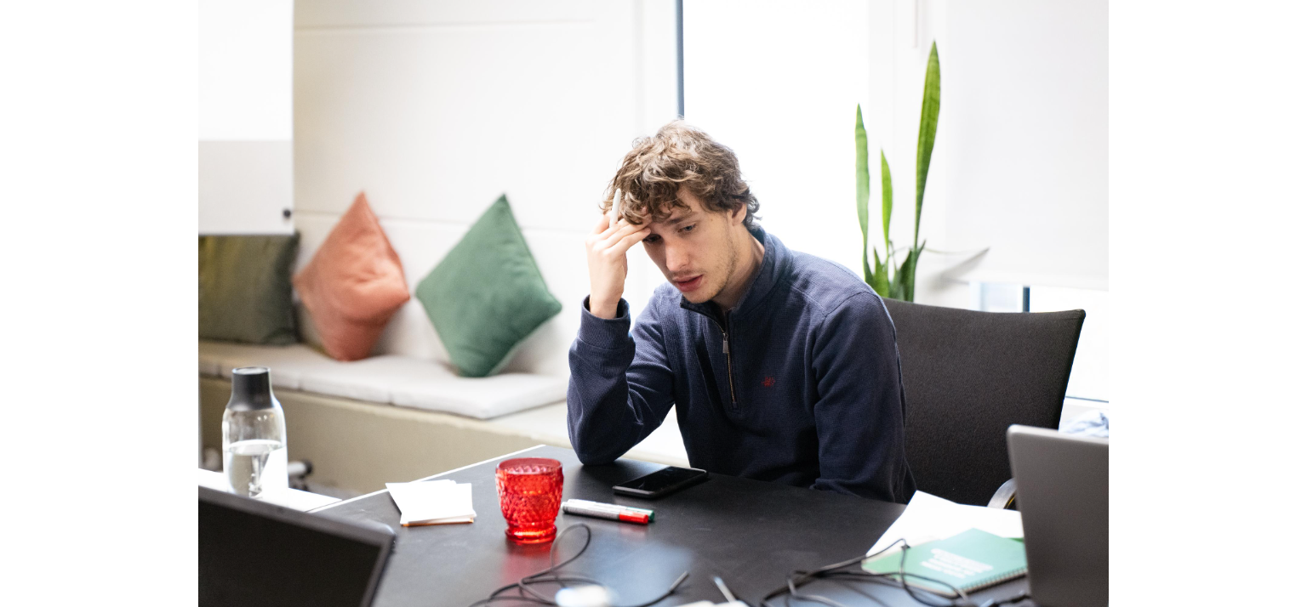

Slide 6
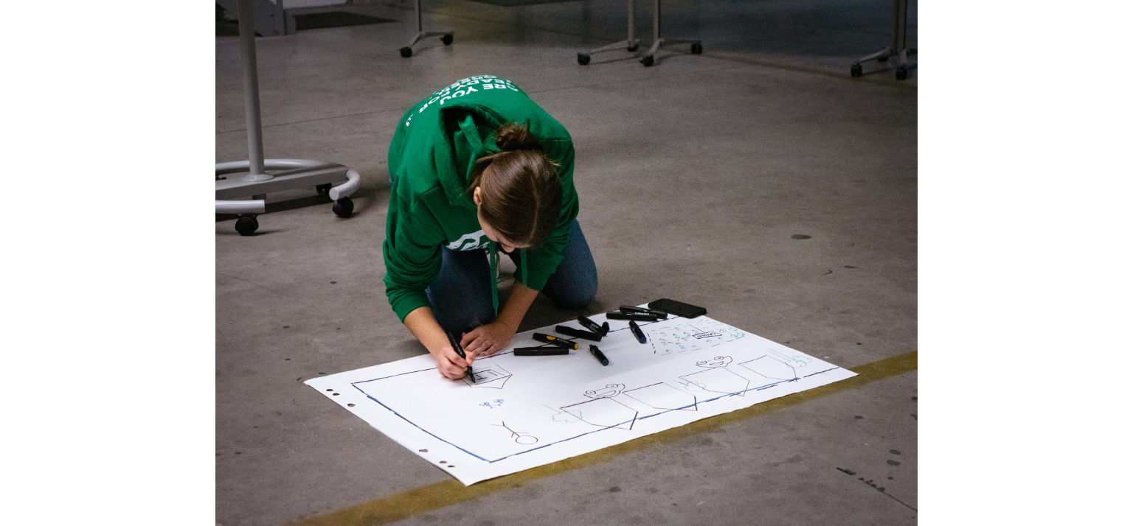

Slide 7
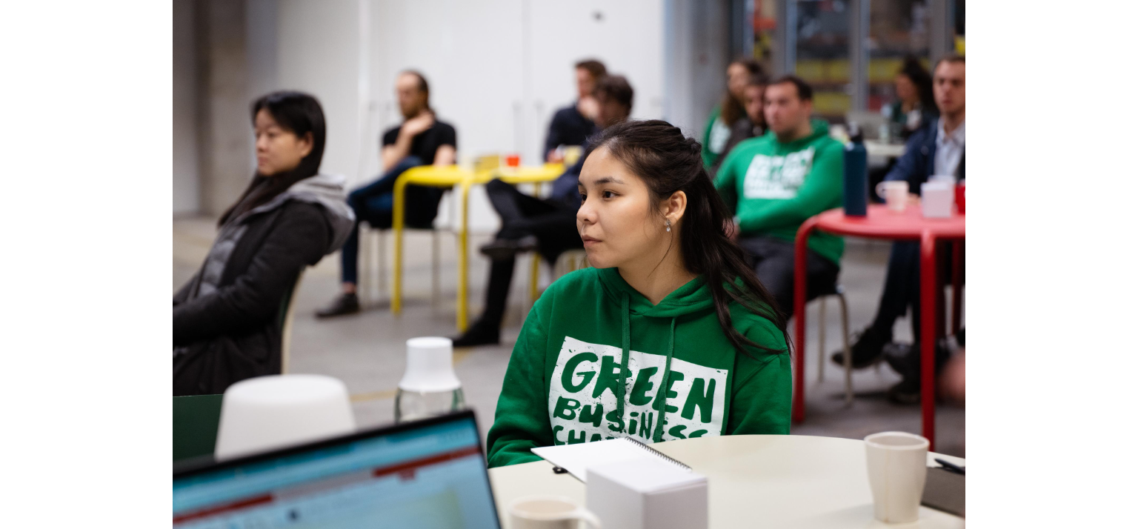

Slide 12
What to expect
Sunday | Monday | Tuesday | Wednesday | Thursday | Friday
Groningen | Leeuwarden | Meppel | Emmen | Oldenburg | Groningen
Introductions | Design thinking | Business development | Building the model | Pitch preparation | Event
Daily stand-ups
Check-ins with your supervisor
Workshops
Work sessions
And of course: fun

Slide 13
Partners of the green business challenge

Slide 14
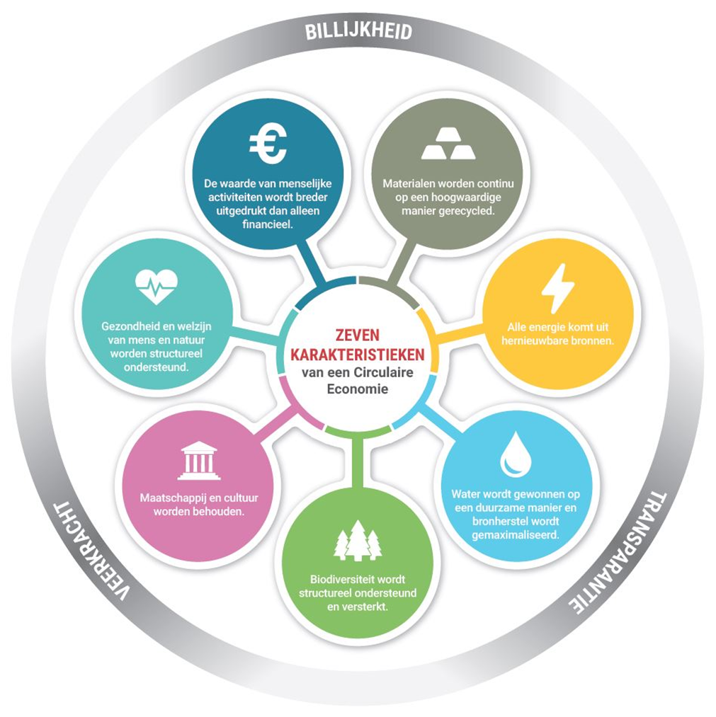
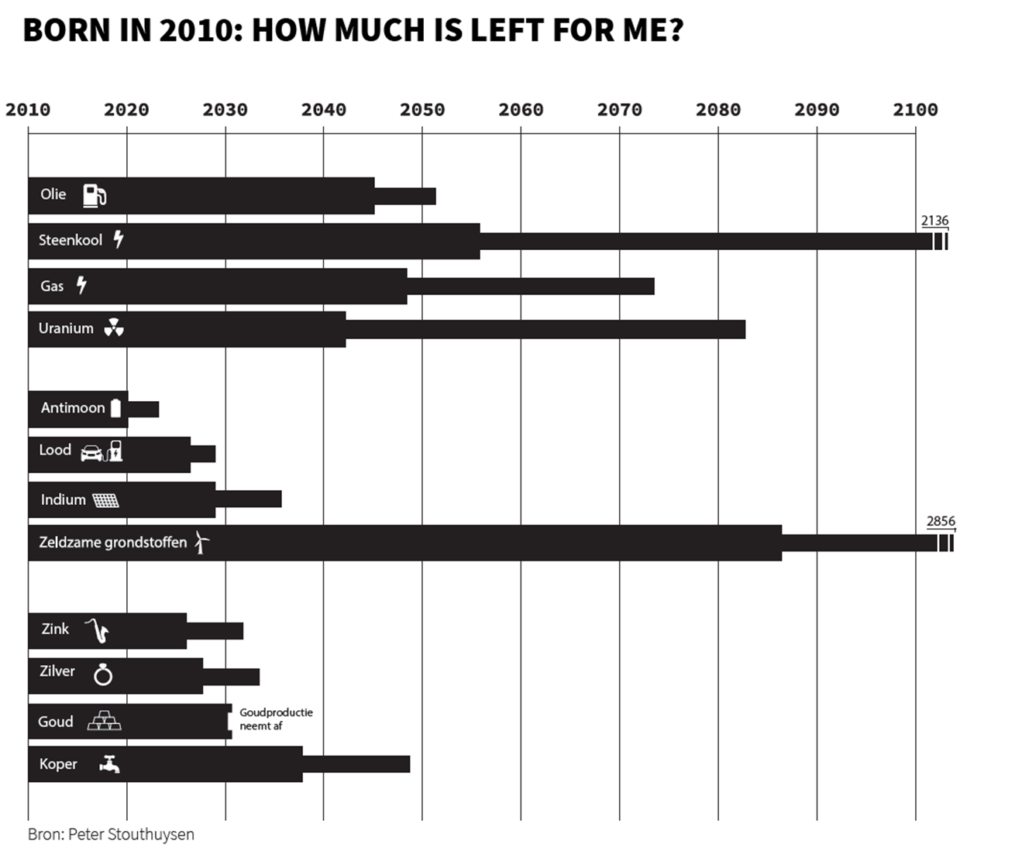

Slide 15
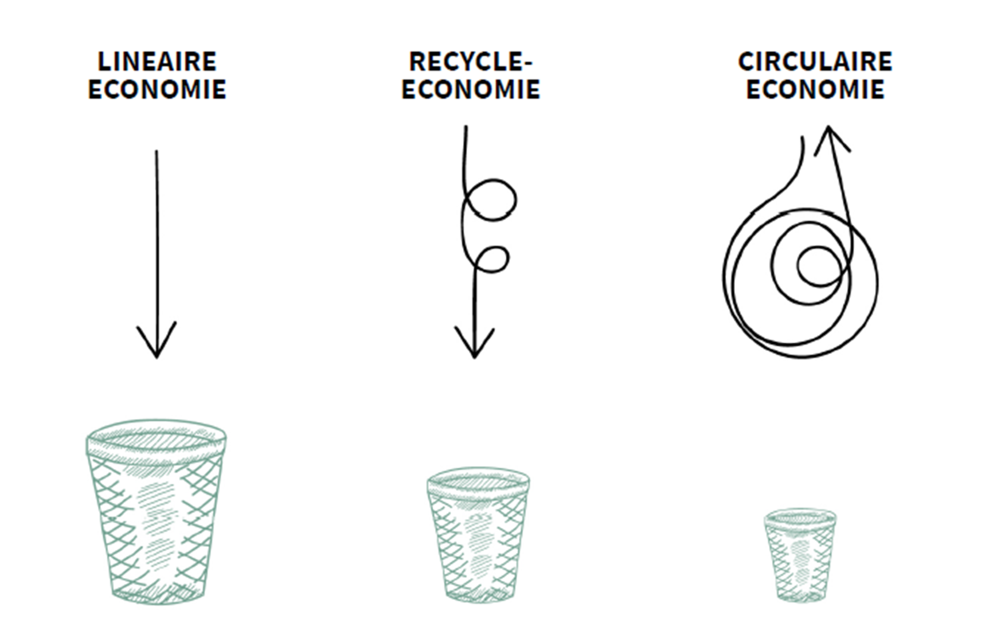

Slide 16
the challenge-owners of 2022

Slide 17
Marne mosterd

Slide 18
TITLE
SUBTITLE

Slide 19
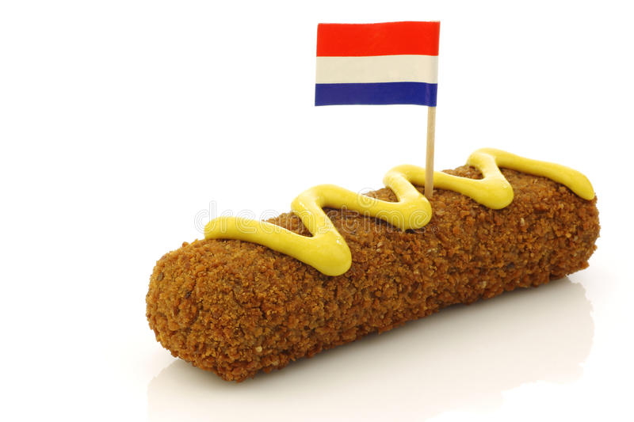
Notes:
Que es un Sachet, explicar donde se vende y para que se usa.

Slide 20
Sachet Composition
Chalk coated paper
PVDC
LDPE
Notes:
Explicar el porqué se utiliza PVDC and LDPE. Porque es difícil reciclar. Hablar sobre las propiedades de cada material.

Slide 21
!
2025
Notes:
El PVDC va a estar prohibido en el 2025, así que tenemos que encontrar una solución; el objetivo es que la solución sea un material reciclable o biodegradable.

Slide 22
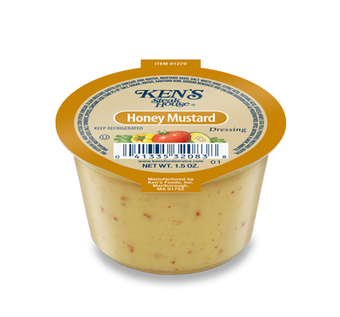
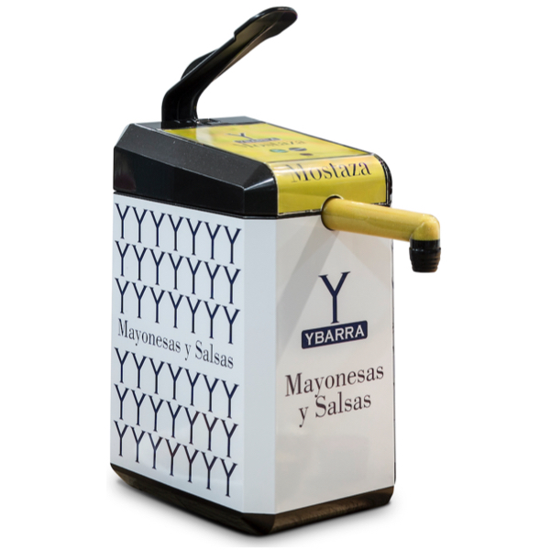
Notes:
Is other package really an option? What do people think? Se imaginan ponerle mostaza a su kroket de una cup?

Slide 23
LDPE PVDC EVOH PVOH PHBH PEF SW
Chemicals
Moisture
Oxygen
Gases
Durable
Biodegradable
?
R
Notes:
Explicar conversación con Corinne sobre plásticos. Esto salio después de hacer research y hablar con diferentes expertos y empresas.

Slide 24
PEF
Notes:
Expliocar lo que hace cada empresa y porque son soluciones a nuestro problema.

Slide 25
PHBH
EVOH
PHBV
6,670.00 USD/ton

Slide 27
THANK YOU FOR YOUR ATTENTION!

Slide 28
KEUNSTO B.V.

Slide 29
Notes:
‘’something extithing

Slide 30
Notes:
Hi!

Slide 31
Notes:
!!!!!!Say from the north for the netherlands

Slide 32
Notes:
Introductie Keunsto

Slide 33
Notes:
What is the goal
Show the product to the audience

Slide 34
Notes:
Our reaearch proces – the life of a infusion bag

Slide 35
Notes:
Whats the future planning?

Slide 38
Notes:
Take my time! Explain the NNRD – about the contact we had with them
Explain more about the partners and we had contact with them

Slide 39
Notes:
Why is NHL stenden here?

Slide 41
Notes:
Explain the remaking a bit better.

Slide 42
Notes:
Explain more – take my time

