Slide 1
AI @ Siemens Onze visie op de ontwikkeling van AI

Slide 2
Kennismaking
Meike de Backker
Accountmanagement & Marketing SITRAIN
Achtergrond
Bedrijfskunde
Arbeidsbemiddeling / Ontwikkeling traineeships
Contact
Meike.debackker@siemens.com
06-57863288
Unrestricted | © Siemens 2023 | Industrial AI

Slide 3
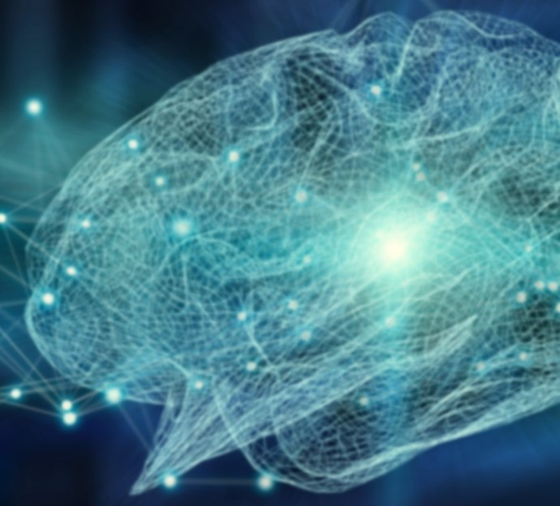
With AI, we enhance our solution capabilities for automation.
Alan Turing
Unrestricted | © Siemens 2023 | Industrial AI

Slide 4
The importance of Artificial Intelligence (AI) for the industry is growing
80 billion Euros is forecast to be the global market of industrial AI by 2026, CAGR 21 – 26: 35%
Product design, quality inspection and process optimization are the top use cases for industrial AI in 2021
Asia Pacific, North America and Europe are leading in AI in the manufacturing landscape with >80% market size in 2021
Source: IoT Analytics: “Industrial AI and AIoT Market Report 2021 – 2026” (2021)

Slide 5
AI helps safeguard the future Mastering increasing complexity and securing competitive advantages with AI
Increase efficiency
Reduce downtimes
Improve quality
Minimize production waste
Lower inspection cost
New business models
AI helps businesses profit through their digital transformation by increasing operational efficiency, mitigating risks and accelerating growth and innovation.

Slide 6
Urgent implications for industry
Decarbonization
Energy efficiency
Resource efficiency
30%
38%
13%
Only
of global CO₂ emissions come from industry
(Source: McKinsey)
of the global energy is consumed by industries
(Source: IEA)
of all global waste is recycled
(Source: Accenture)
Notes:
Industry is particularly challenged, as we are massive contributors to the current climate ills. After all, industry is responsible for 20% of global CO2 emissions and more than a third of global energy consumption.
Because of this, it is critical for industry to identify new opportunities for decarbonization, and innovation to reduce energy consumption while getting the same job done. When looking at global waste, only 13% is recycled, making it imperative for industry to reduce their carbon footprint and transition towards a circular economy with the efficient use and re-use of materials.

Slide 7
Our customers’ challenges are increasing – with new ones on top of them.
Cost pressure &
efficiency
Faster innovation cycles
Sustainability
Quality
Flexibility
Lack of talent
Notes:
Our customers are facing increasing pressure.
Many of their usual challenges are increasing more and more:
Cost pressure, which mandates increase in efficiency for equipment and processes
Faster innovation cycles, bringing new product ideas quickly into serial production
Quality, quality of products
Flexibility, in what and how customs produce, but also as a means to be more resilient
And on top of this, there’s now also the pressing need for more sustainability and at the same time a growing lack of skilled workforce.
Sustainability, which became a license to operate – not a nice to have!
Lack of talent, with experienced staff retiring at a massive scale and not enough people available who have IT skills

Slide 8
AI and the human factor
AI empowered employees
AI will not replace human workers in production. Rather, it will remain a supplementary function for a fruitful collaboration of humans and machines.
People are and will be your most important resource. Giving them the tools, they need to do their jobs safely and effectively is a main advantage of AI.
By automating simple, repetitive tasks AI will make work more productive, less vulnerable to error and provide more time for creative work.
Employees will always take precedence whenever there is a need for creativity, control, application, training, or troubleshooting.

Slide 9
AI is making its way into all industries With maximum benefit for the factory of tomorrow
Visual inspection
Electronics
Anomaly detection
Aerospace
Process optimization
Mechanical engineering
Battery
Application areas
Artificial Intelligence
Quality prediction
Industries
Tire
Lifespan prediction
Automotive
Predictive maintenance
Robotics
Object recognition
Food and beverage
Autonomous systems
Additive manufacturing
and many more

Slide 10
AI in ons dagelijks leven
AI
Siri, Google Now
Fraude detectie
Waze, Google Maps etc.
Customer Support
Aankoopvoorspellingen
Camera monitoring
Videogames
Spotify/Netflix
Unrestricted | © Siemens 2023 | Industrial AI

Slide 11
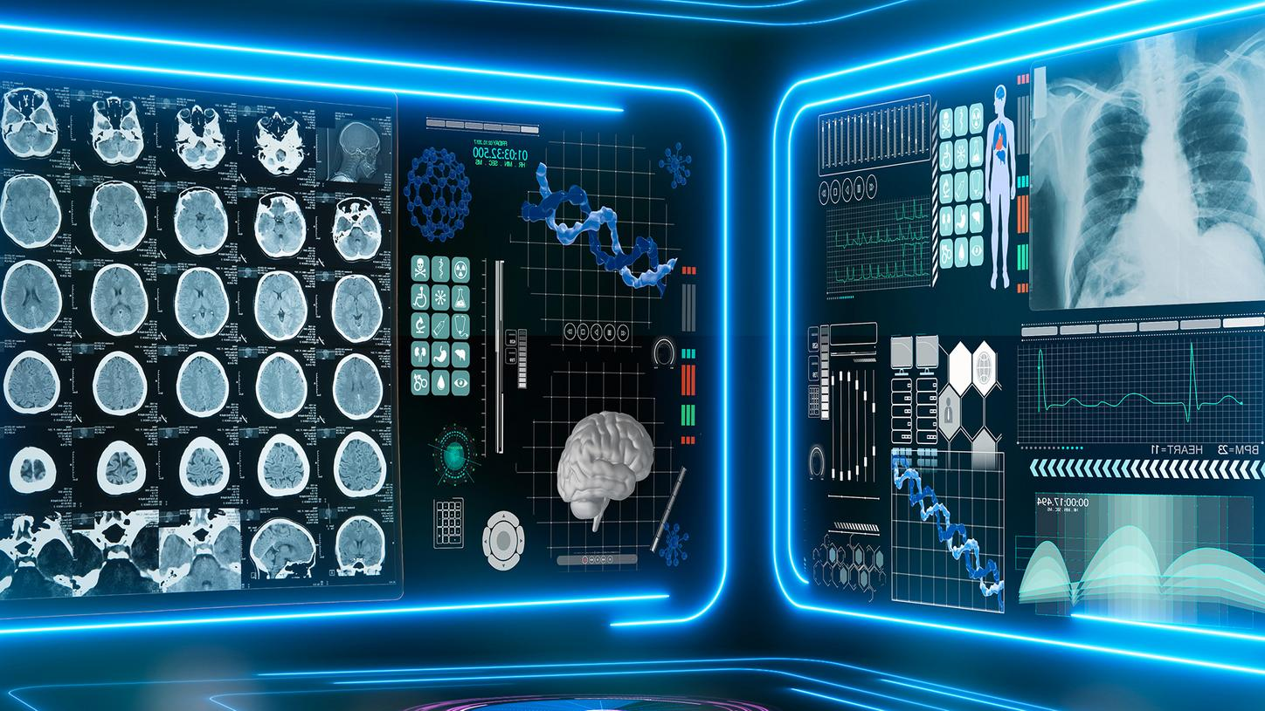
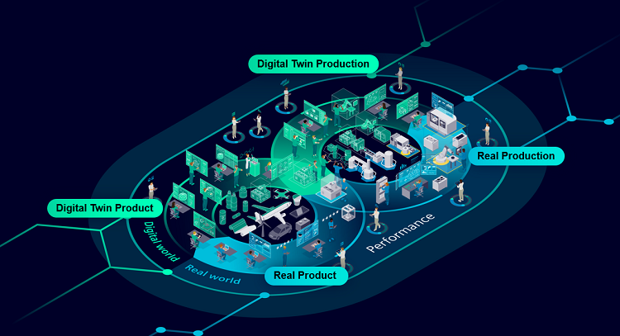
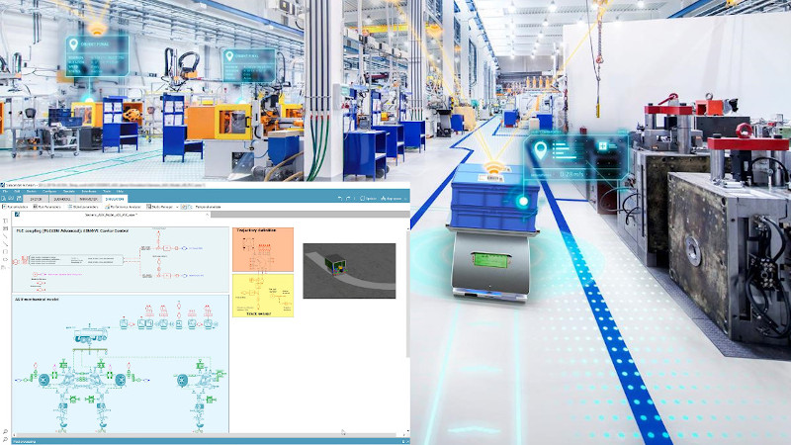
Wat doet Siemens op het gebied van AI?
Explainable AI
Trustworthy AI
Active learning
Federated learning
Differential Privacy
Unrestricted | © Siemens 2023 | Industrial AI
Notes:
Explainable AI >> in de industry willen we graag weten hoe bepaalde beslissingen tot stand zijn gekomen. Wanneer we het begrijpen, kunnen we risico’s beter inschatten.
Active Learning >> AI moet leren van de kennis van domein experts. Daarom zal AI in industry vaker aanbevelingen doen, die dan door een operator/domein expert moet worden bestigd. Hiervan leert het AI model dan weer.
Trustworthy AI >> AI moet steeds worden gemonitored om te bepalen of het model nog voldoet. De omstandigheden kunnen zijn veranderd zodat het AI model niet meer naar behoren functioneert.
Federated Learning >> een AI model kan beter worden getraind wanneer het data krijgt van een groot aantal verschillende bronnen, liefst van verschillende bedrijven. Dan kom je wel bij het vraagstuk: van wie is de data, waarvoor mag de data worden gebruikt en wie is dan uiteindelijk de eigenaar van het getrainde model
Differential Privacy >> data mag niet terug te voeren zijn op individuele personen. Daarvoor zijn er technieken om data te anonimiseren en privacy van personen te waarborgen.

Slide 12
Wat doet Siemens op het gebied van AI?
Wat merken medewerkers?
AI ter ondersteuning
Manier van werken anders
Productiever
Hoe bereid je medewerkers voor?
Trainen in gebruik en gevaren van ChatGPT en andere slimme platformen.
Change management.
Unrestricted | © Siemens 2023 | Industrial AI
Notes:
Automatisch genereren (door chatGPT) van werkinstructies uit systemen in begrijpelijke taal
Vertalen Teams chats
ChatGPT voor PLC code/software code te genereren, fouten in software op te sporen, storingzoeken, optimalisatie
Handleidingen genereren
Omvangrijke documenten doornemen en samenvattingen te geven.
Andere werkinhoud – het maakt ons werk niet ingewikkelder maar juist makkelijker

Slide 13
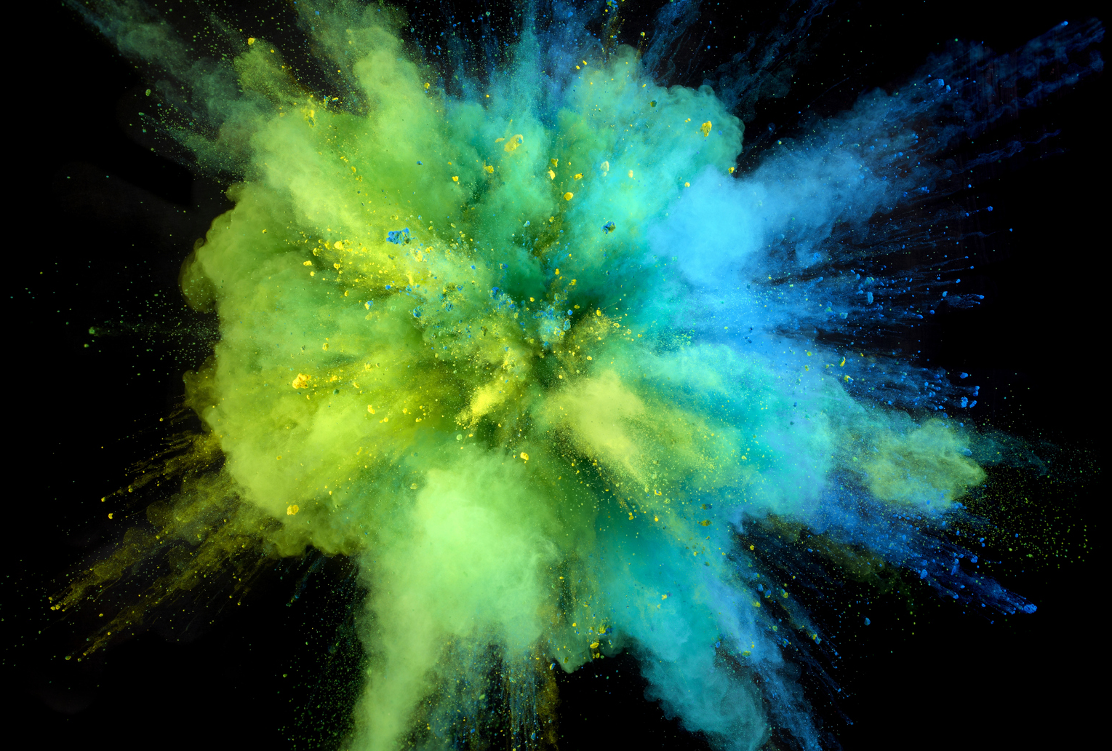
De toekomst is samenwerken
met AI
Notes:
Key take aways:
Kan autonoom, maar altijd check door mensen (voorbeeld arts).
Ondersteunend aan, niet ter vervanging van
Andere werkinhoud – niet moeilijker maar juist makkelijker (voorbeeld navigatie)
Vooral sneller en productiever (storingzoeken, handleidingen etc)

Slide 14
Q&A
Houston, we have some questions!

